Slide 1
Common Random Numbers in Discrete Event Simulation for Disease Modeling: A Statin Treatment Case Study
Hanxuan Yu¹, hanxuan.a.yu@vumc.org
John Graves¹, Shawn Garbett², Ashley A. Leech¹, Jinyi Zhu¹
Presented at the 45th Annual Meeting of the Society for Medical Decision Making, October 2023
¹Department of Health Policy, Vanderbilt University School of Medicine, Nashville, TN
²Department of Biostatistics, Vanderbilt University School of Medicine, Nashville, TN

Slide 2
No conflicts of interest

Slide 3
Common Random Numbers(CRNs)
To reduce the stochastic noises between simulation iterations
“CRN is the coordinated or synchronized use of random numbers such that the same random numbers are ‘common’ to the same stochastic events across all model runs.”(Stout & Goldie, 2008)
Already been applied in micro-simulation, but under-explored in discrete event simulation for disease modeling

Slide 4
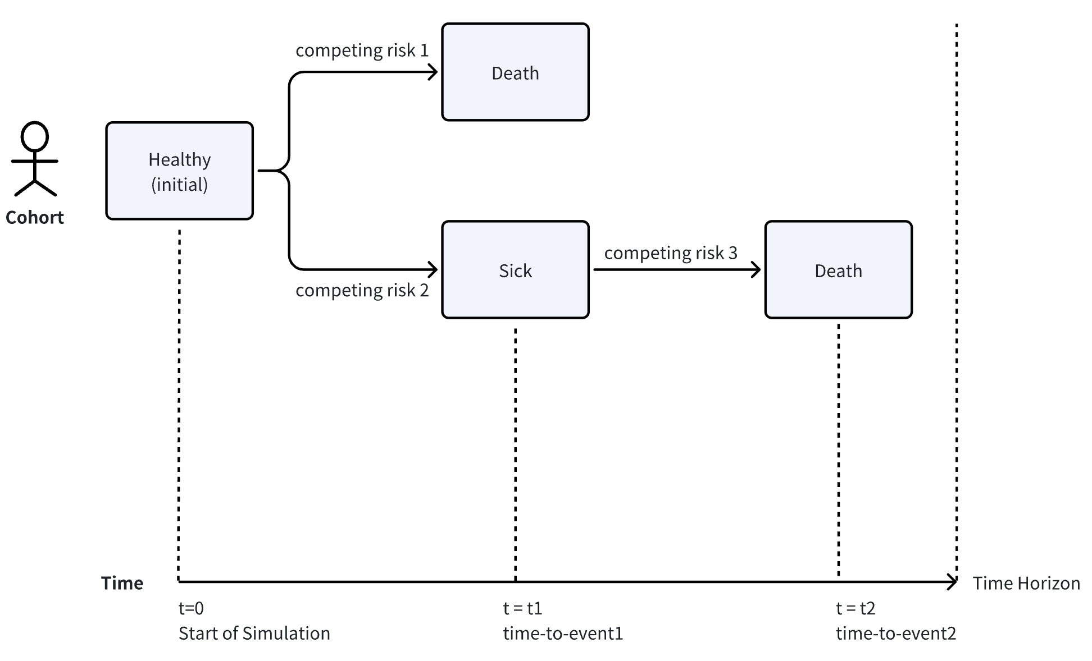
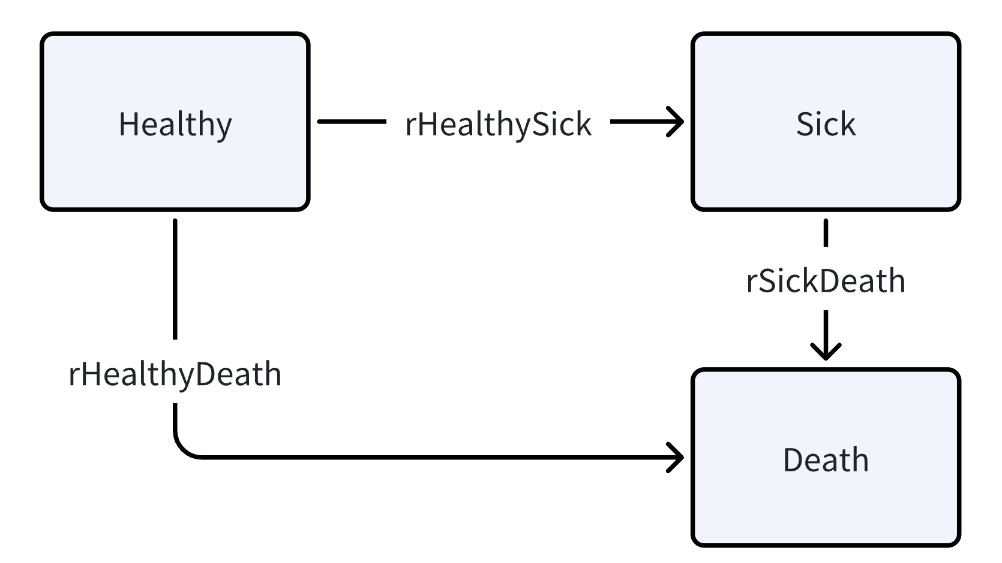
Discrete Event Simulation(DES)
RN t_BGdeath
RN t_sick
RN t_sickdeath
A simple structure of the DES model

Slide 5
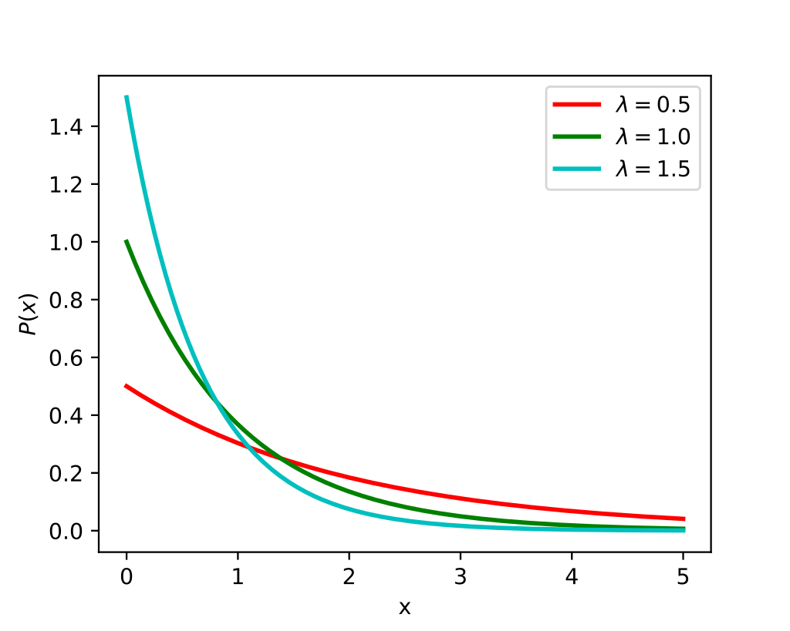
Distribution for time-to-event analysis
How to generate random numbers for the time-to-event
Inverse Cumulative Distribution Function
Generate a uniform random number u in (0,1);
The quantile u gives the corresponding time.
u = 0.95
Source from wiki/Exponential_distribution
Notes:
t = ln(1-u)/(-λ), λ is the rate;

Slide 6
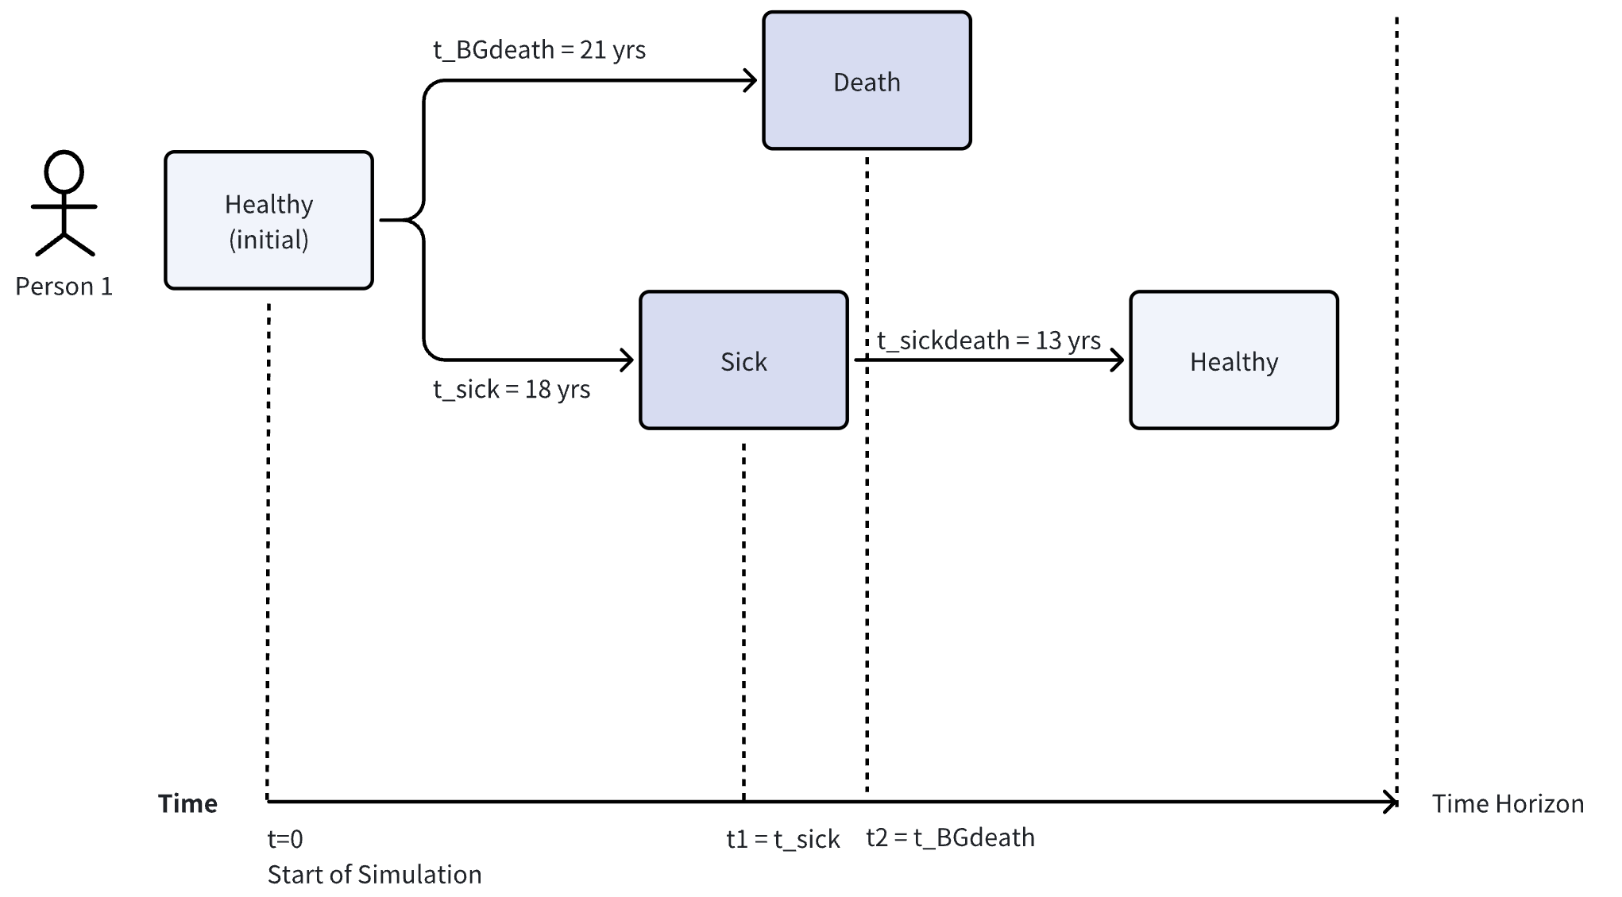
Healthy-Sick-Death Example
Set seed, No CRN;
In status quo, rHealthySick = 0.1.
rHealthyDeath = 0.03
rHealthySick = 0.1
rSickDeath = 0.2
Person 1,
LE = 21 yrs
H -> S -> BGdeath
1 | 0.467 | t_BGdeath | 21 yrs
2 | 0.834 | t_sick | 18 yrs
3 | 0.926 | t_sickdeath | 13 yrs
4 | 0.593 | t_BGdeath | 30 yrs
5 | 0.959 | t_sick | 32 yrs
6 | 0.808 | t_BGdeath | 55 yrs
7 | 0.393 | t_sick | 5 yrs
8 | 0.889 | t_sickdeath | 11 yrs
9 | 0.189 | t_BGdeath | 7 yrs
… | … |  | …
Person 2,
LE = 30 yrs
H -> BGdeath
Person 3,
LE = 16 yrs
H -> S -> SickDeath
Notes:
t = ln(1 - q) / (-rate), q = 1 - exp(- rate * t), rate is the lambda

Slide 7
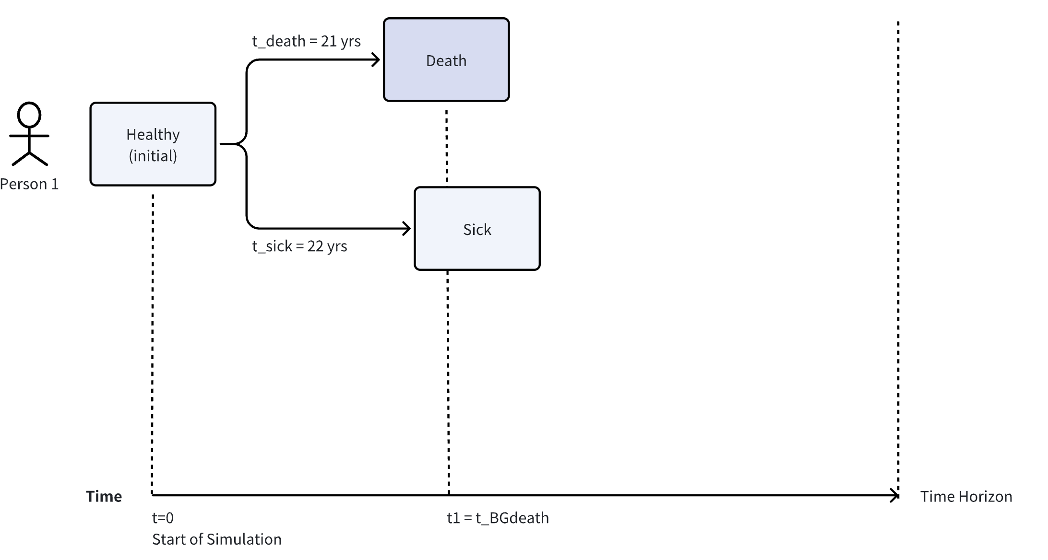
Healthy-Sick-Death Example
Set seed, No CRN;
An intervention reduces rHealthySick to 0.08.
rHealthyDeath = 0.03
rHealthySick = 0.08
rSickDeath = 0.2
Person 1,
LE = 21 yrs
H -> BGdeath
1 | 0.467 | t_BGdeath | 21 yrs
2 | 0.834 | t_sick | 22 yrs
3 | 0.926 | t_BGdeath | 87 yrs
4 | 0.593 | t_sick | 11 yrs
5 | 0.959 | t_sickdeath | 16 yrs
6 | 0.808 | t_BGdeath | 55 yrs
7 | 0.393 | t_sickdeath | 6 yrs
8 | 0.889 | t_sickdeath | 11 yrs
9 | 0.189 | t_BGdeath | 7 yrs
… | … |  | …
The following simulated events were also impacted due to the random number misalignment.
Person 2,
LE = 27 yrs
H -> S -> Sickdeath
The noise can be misleading. With lower prevalence,
It seems that the life expectancy is also lower.
Person 3,
LE = 17 yrs
H -> S -> SickDeath
Notes:
Make up numbers that with a better intervention, a person survive from the BG death but die with t_sick+t_death < initial t_death

Slide 8
Common Random Numbers(CRNs)
Person 1 (LE = 14 yrs) |  |  | Person 2 (LE = 10 yrs) |  |  | Person 3 (LE = 20 yrs) |  | … | …
t_Sick (r = 0.1) | t_BGDeath (r = 0.03) | t_SickDeath (r = 0.2) | t_Sick (r = 0.1) | t_BGDeath (r = 0.03) | t_SickDeath (r = 0.2) | t_Sick (r = 0.1) | t_BGDeath (r = 0.03) | t_SickDeath (r = 0.2) | …
0.467 (6 yrs) | 0.661 (36 yrs) | 0.805 (8 yrs) | 0.596 (9 yrs) | 0.375 (23 yrs) | 0.199 (1 yr) | 0.538 (8 yrs) | 0.305 (12 yrs) | 0.986 (21 yrs) | …
Status quo
rHS = 0.1
Person 1 (LE = 16 yrs) |  |  | Person 2 (LE = 12 yrs) |  |  | Person 3 (LE = 22 yrs) |  | … | …
t_Sick (r = 0.08) | t_BGDeath (r = 0.03) | t_SickDeath (r = 0.2) | t_Sick (r = 0.08) | t_BGDeath (r = 0.03) | t_SickDeath (r = 0.2) | t_Sick (r = 0.08) | t_BGDeath (r = 0.03) | t_SickDeath (r = 0.2) | …
0.467 (8 yrs) | 0.661 (36 yrs) | 0.805 (8 yrs) | 0.596 (11 yrs) | 0.375 (23 yrs) | 0.199 (1 yr) | 0.538 (10 yrs) | 0.305 (12 yrs) | 0.986 (21 yrs) | …
Intervention
rHS = 0.08
Random Numbers For each event and each person.
A lower prevalence leads to an improved life expectancy.

Slide 9
Common Random Numbers (CRNs)
Pros
Cons
Reduces
stochastic noises
Less trajectories
to converge
Programming complexity
Indicate the gap
when varying params
Helps
sensitivity analysis
RN generator
computational time

Slide 10
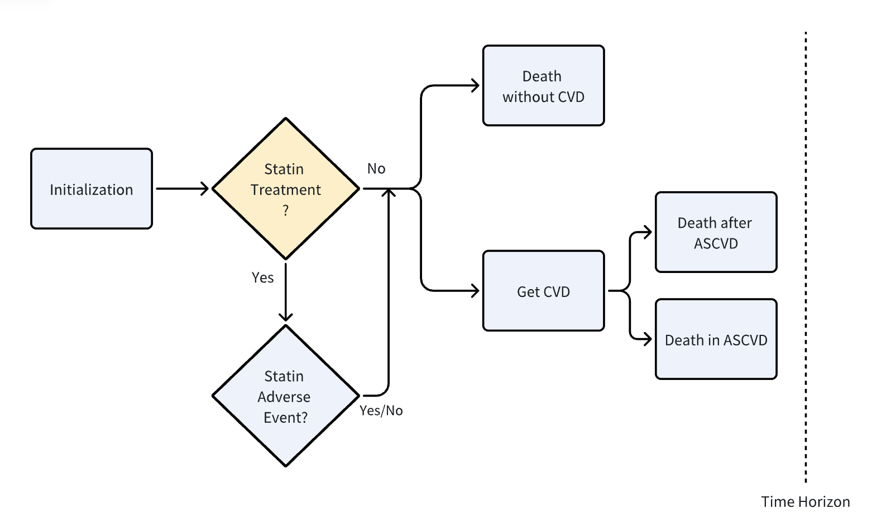
Case Study: Statin Treatment
Cohort: US people aged 40~80 at the risk of atherosclerotic cardiovascular disease (ASCVD), populated with the National Health and Nutrition Examination Survey.
Parameterization: Spahillari A., etc. (2020)
Strategy: Use Statins / Not Use
Outcome: Net Health Benefit(NHB)
Flow Chart of the Simulation Model

Slide 11
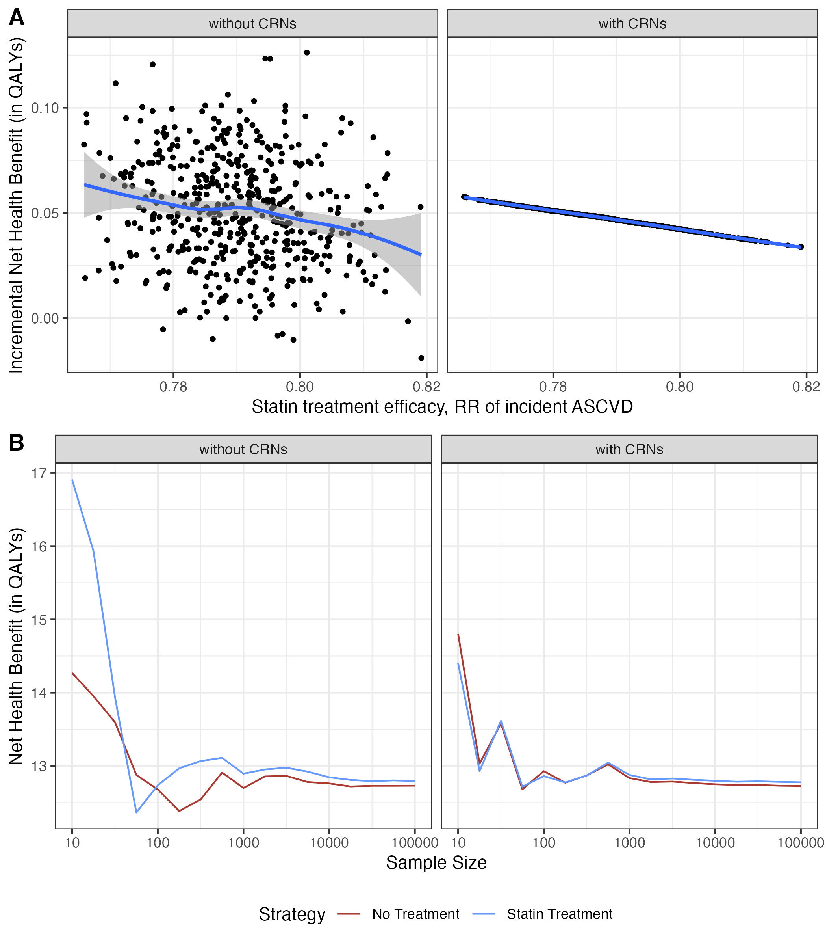
Effect of CRNs on Model Outputs
When running the one-way sensitivity analysis for the relative risk of ASCVD (where a lower RR leads to a higher incremental NHB), CRN reduced the stochastic noise.

Slide 12
Effect of CRNs on Model Outputs
CRNs resulted in faster stabilization of the model-estimated iNHB around the true value with smaller sample sizes.

Slide 13
Conclusions
Reduce the noise around the true value;
Enhance efficiency in computationally intensive tasks.
PSA, calibrations, VOI…

Slide 14
Thank You for Listening!
Email: hanxuan.a.yu@vumc.org
Twitter: @hanxuan_yu

